Slide 1
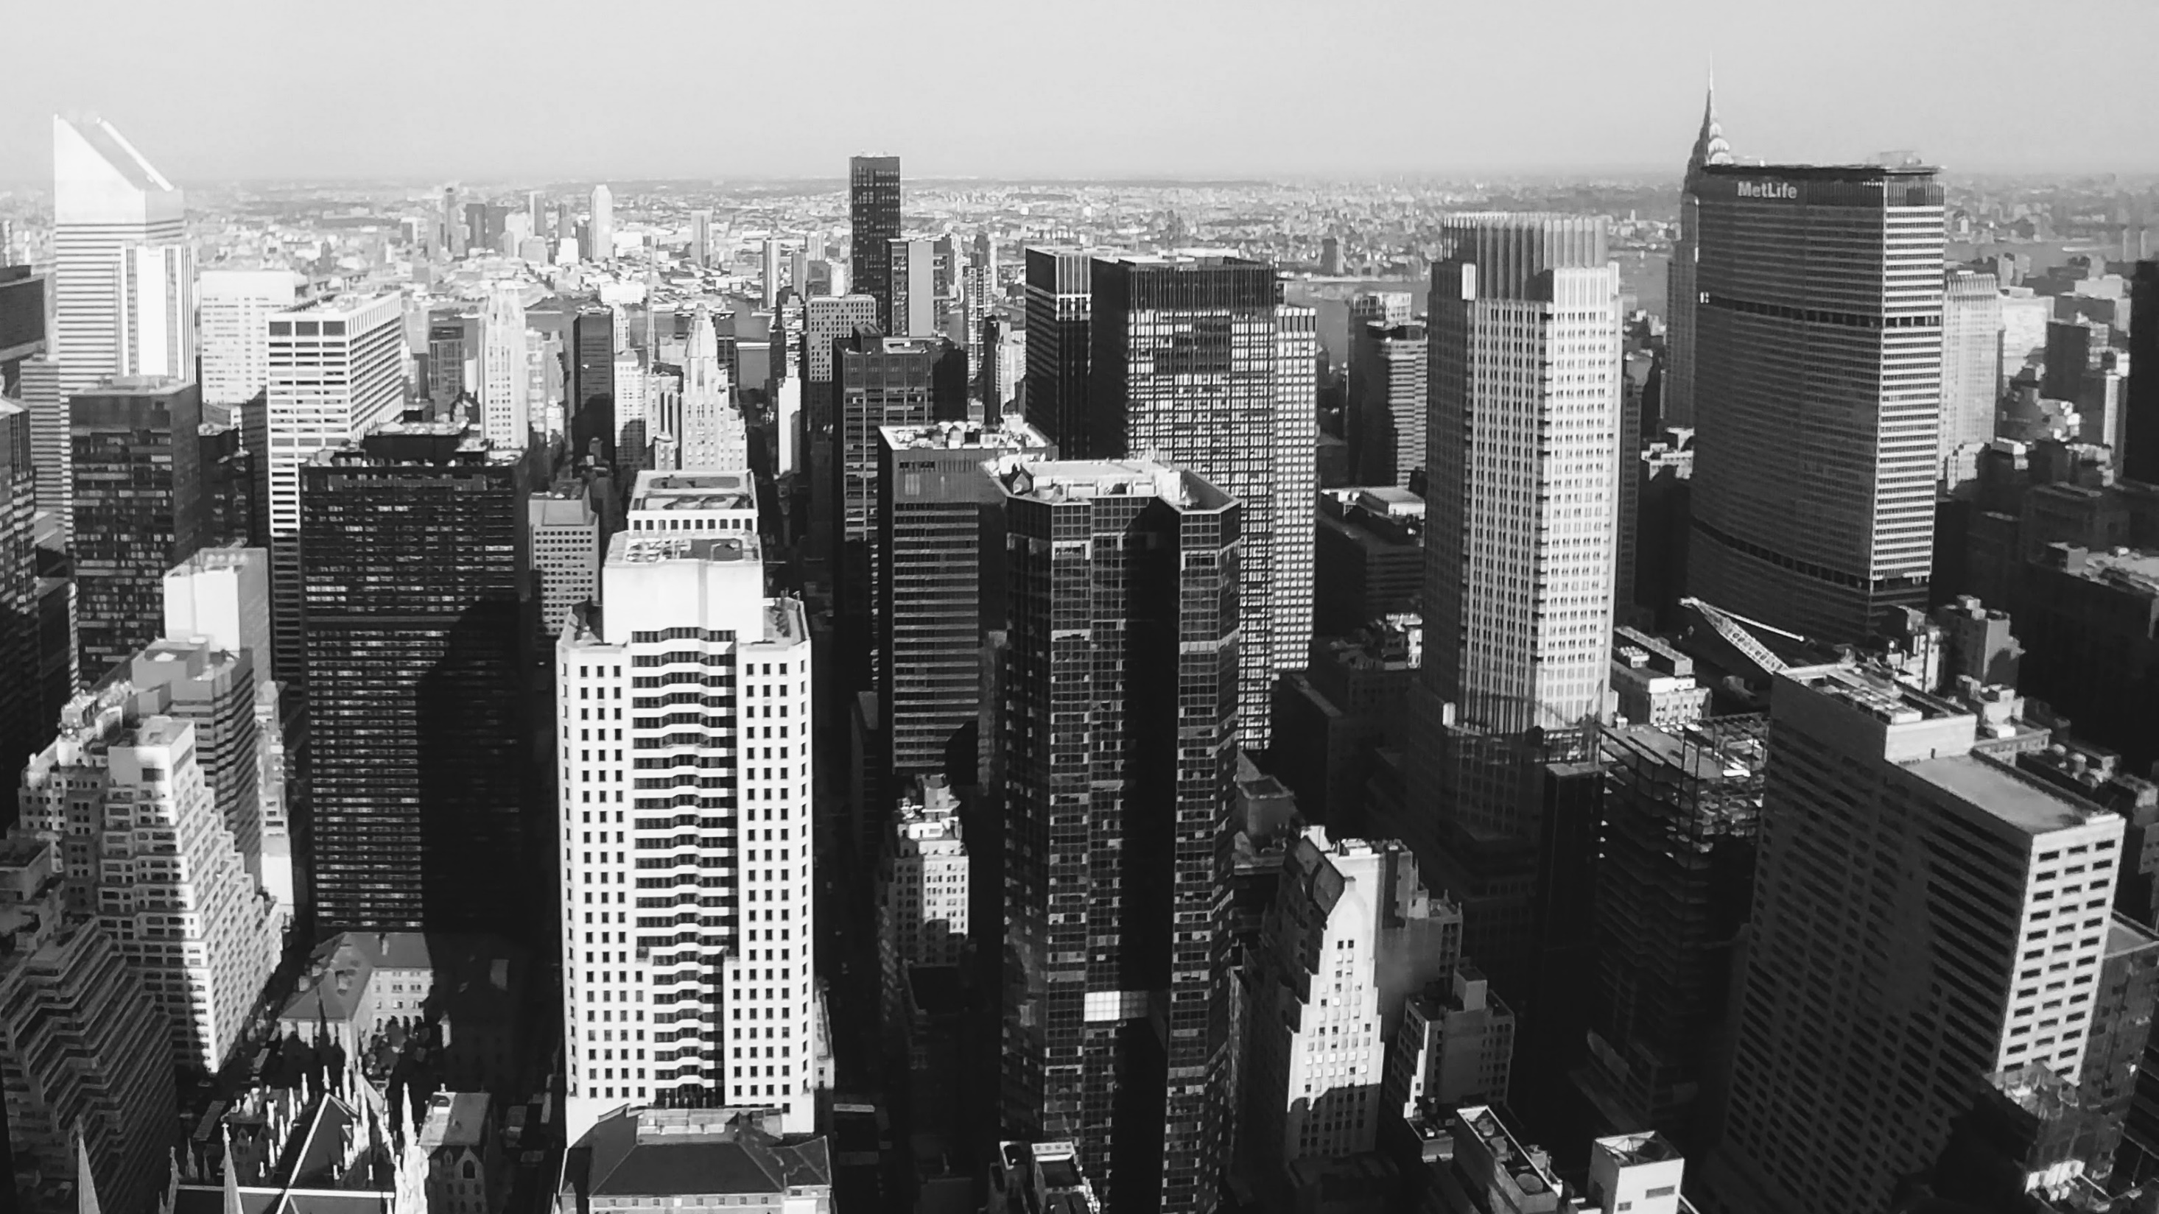
Folie 1
PREDICTING SEATTLE´S SEVERE COLLISIONS
Coursera Capstone Project
René Fernando Duarte

Slide 2
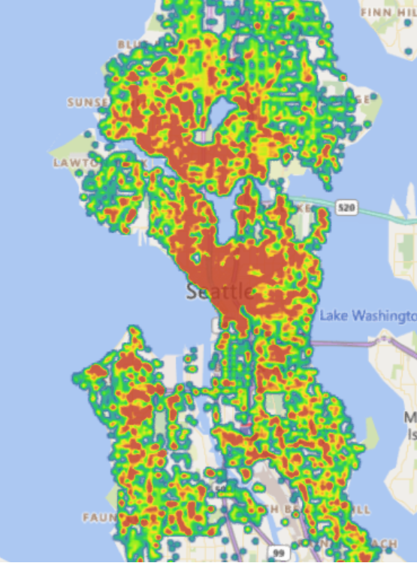
IMPORTANCE OF PREDICTING COLLISIONS
All SEATTLE COLLISIONS 2004-2020
Most common transportation method
Saving lives & permanent injuries
Create Awareness
Vulnerable Locations
Fitting the Data into Machine Learning Models
Reducing Traffic

Slide 3
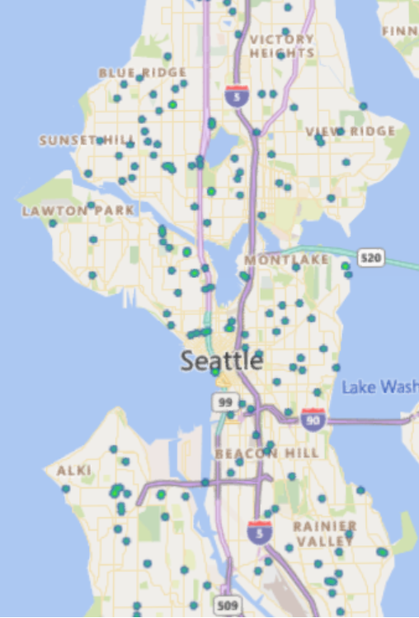
DATA ACQUISITION AND CLEANING
UNDER INFLUENCE COLLISIONS 2004-2020
Seattle Police Department dataset / Coursera
All Collisions recorded since 2004
38 Columns (Conditions) & approx. 200,000 incidents
Including latitude & longitude, weather, light & road conditions among others.
Columns with few values were added to „Others“
Blank Status were eliminated
NaN & Dummy Values
Columns transformed to 0s and 1s

Slide 4


Folie 7
MACHINE LEARNING MODELS RESULTS
63.90%
61.12%
62.48 %
In order to predict the locations of possible severity collisions in Seattle, the map predictions are created using the Support Vendor Machine results of 62.48% accuracy.

Slide 5
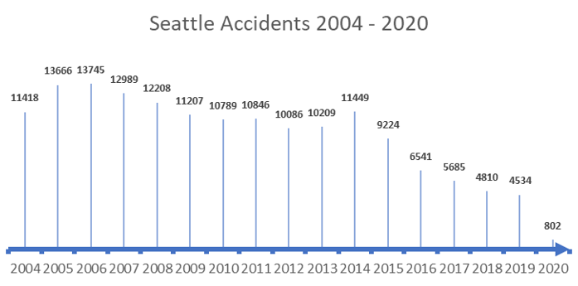
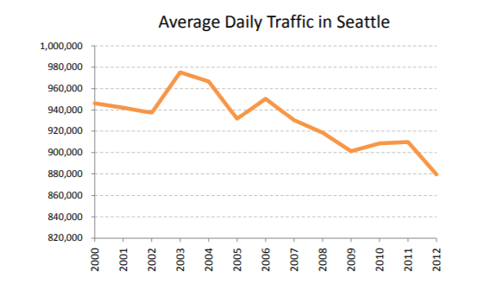
SEATTLE TOTAL ACCIDENTS VS TRAFFIC

Slide 6
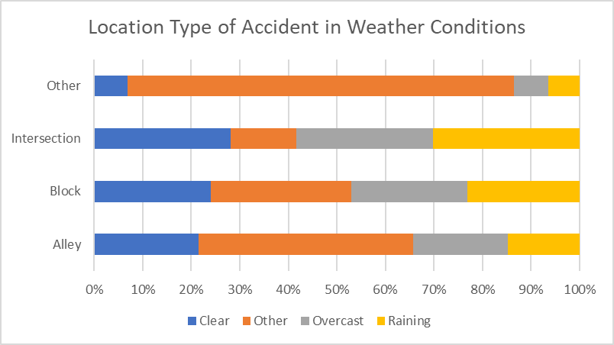
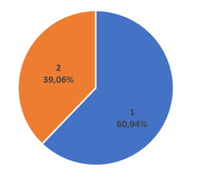
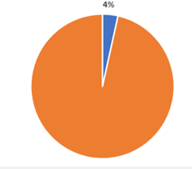
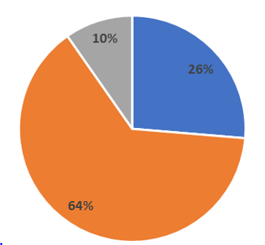
Folie 2
COLLISION CONDITIONS
Severity of Collisions under Influence
Accidents under Influence from Total Collisions
Light Conditions in Collisions
2

Slide 7
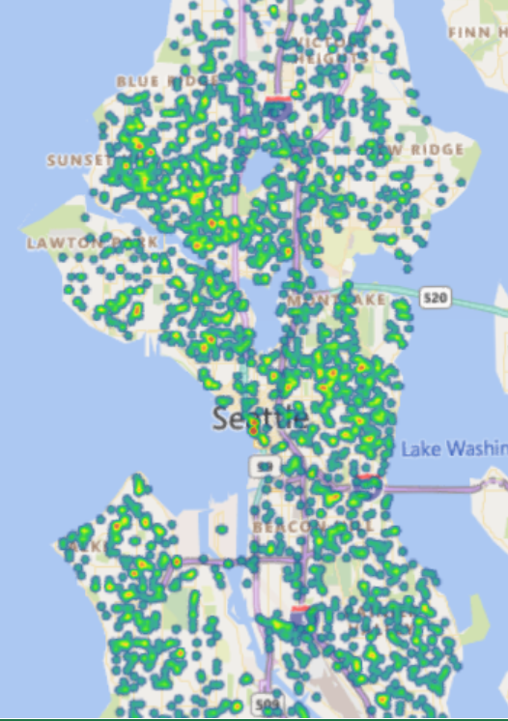
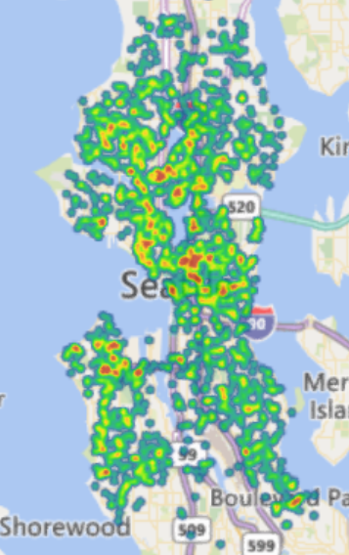
SEATTLE MAP WITH ALL ACCIDENTS 2004 - 2020
Severity Collisions 1
Severity Collisions 2

Slide 8
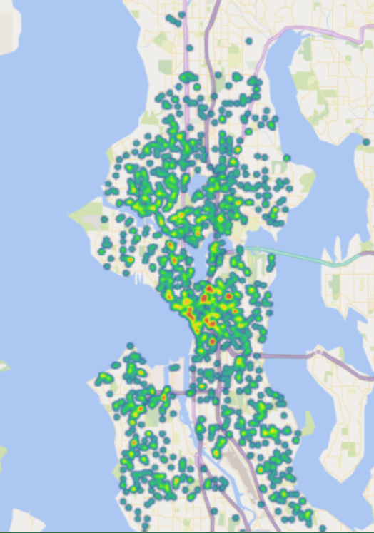
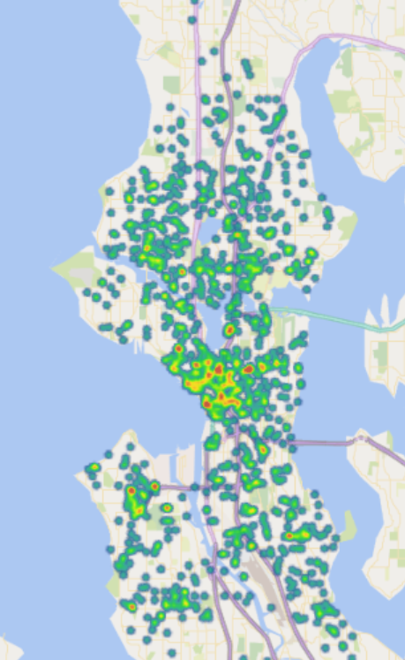
SEATTLE MAP WITH SEVERITY 2 ROAD + LIGHT CONDITIONS 2004 - 2020
With Daylight
Without Daylight (Dark)

Slide 9
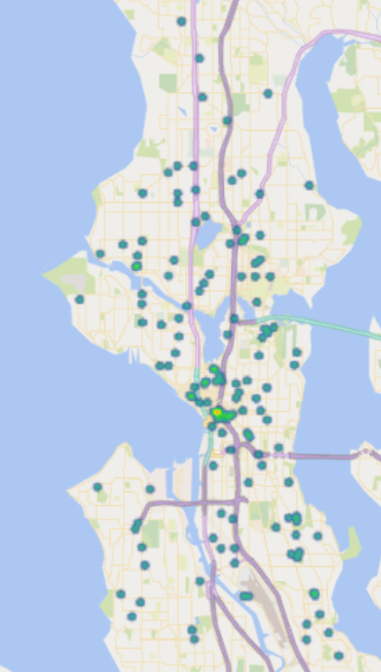
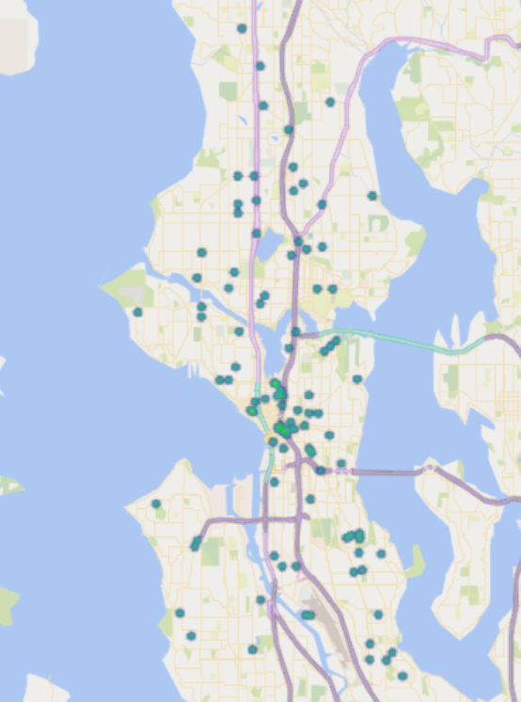
SEATTLE MAP WITH SEVERITY 2 WEATHER + ROAD + LIGHT CONDITIONS 2004 - 2020
DARK WITH STREETS LIGHTS & ILUMINATION
DARK WITHOUT STREETS LIGHTS OR ILUMINATION

Slide 10
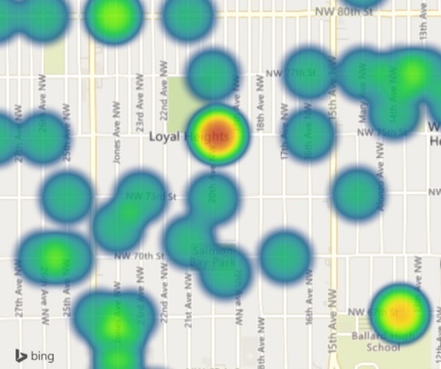
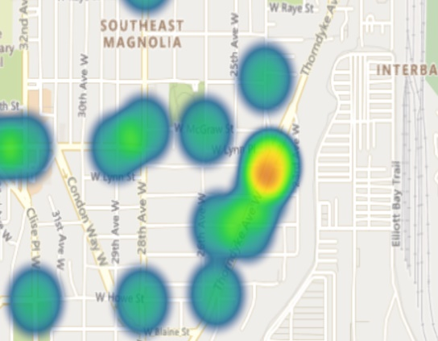
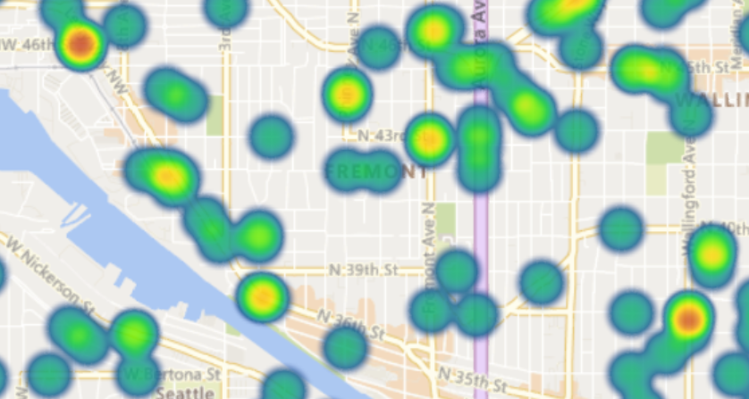
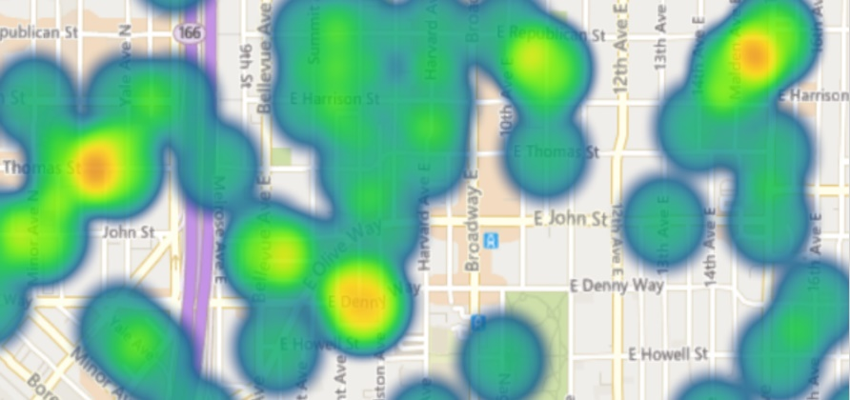
PREDICTION OF SEATTLE SPEEDING COLLISION LOCATIONS
SEVERE TYPE 1
SEVERE TYPE 2

Slide 11
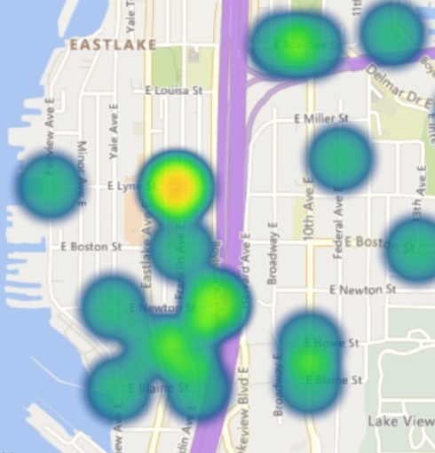
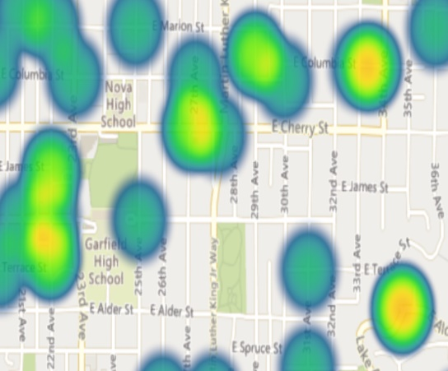
PREDICTION OF SEATTLE UNDER INFLUENCE COLLISION LOCATIONS
SEVERE TYPE 1
SEVERE TYPE 2

Slide 12
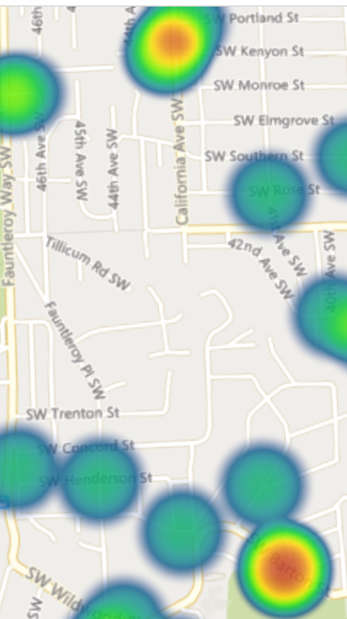
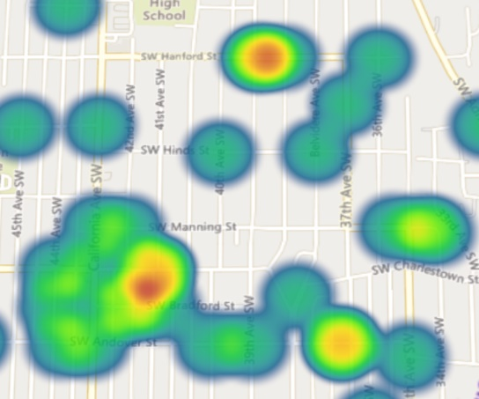
PREDICTION OF SEATTLE WITH RAINING & OUTCAST CONDITIONS, WET, SNOW & ICE ROAD CONDITIONS AT DARK & MISSING ILUMINATION COLLISION LOCATIONS
SEVERE TYPE 2
SEVERE TYPE 2

Slide 13
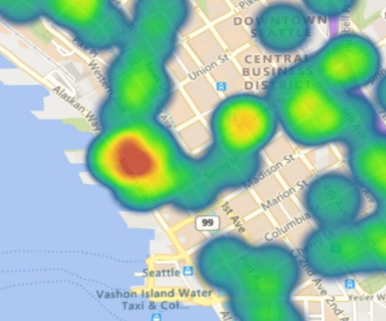
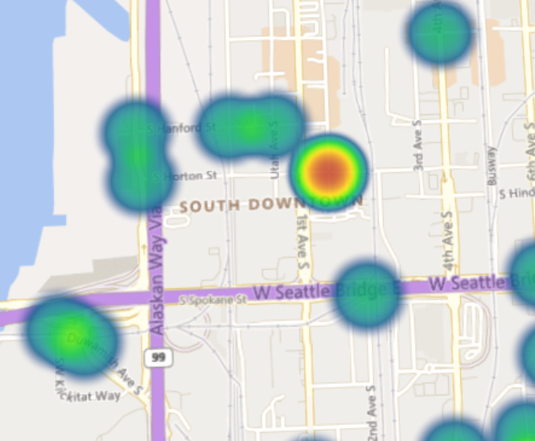
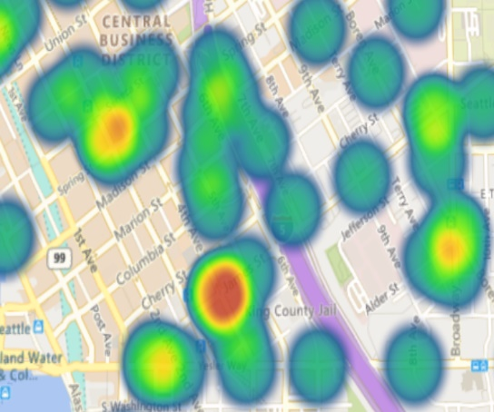
PREDICTION OF SEATTLE WITH RAINING & OUTCAST CONDITIONS, WET, SNOW & ICE ROAD CONDITIONS AT DARK & MISSING ILUMINATION COLLISION LOCATIONS
SEVERE TYPE 1
SEVERE TYPE 2

Slide 14
Folie 9
CONCLUSIONS AND FUTURE DIRECTIONS
COLLISION PREDICTIONS
PREDICTIVE LOCATIONS
Can be predicted with precise acuracy based on external conditions
Based on each condition sensitive locations can be reinforced by society and local government
Collision Reduction since 2004 has led to major Traffic Reduction in Seattle
LIVE-FED SYSTEM
External Conditions are not the main cause for severe Collisions
SPEEDING
Improve facilities, signs & Iluminations
APPLICATION / ALERT MEASURES
Is the most common cause of Severe Collisions
To alert all drivers when the conditions are present for collisions to occur
Ihr Logo
9

Slide 15

Folie 11
THANK YOU

